Slide 1
Time Series for Beginners
Presented By :Avijit Nandy
Bangalore R User Group Meet up – 10th February 2019

Slide 2
About me
Currently working as Financial Data Analyst at Moody’s Investor Service
Post Graduate in Economics from Banaras Hindu University
Passed CFA Level 1 in January 2019
Areas of interests are Data Visualization, Algorithmic trading, Equity research, Machine Learning

Slide 3
Story of My Garden

Slide 4
Types of Data based on Data Collection Method
Cross Sectional Data
Time Series Data
Panel Data

Slide 8
Time Series
Time series data is a collation of data points, collected in a sequence, generally at fixed time interval

Slide 9
Components of a Time series
Trend
Seasonal variations
Cyclical component
Irregular component

Slide 10
Method of combining Components of Time Series
Additive method : time_series = Trend + Seasonal + Cyclical + irregular
Multiplicative method : Time_series = Trend × Seasonal × Cyclical × irregular
decompose function in R is very helpful in identifying these components

Slide 11
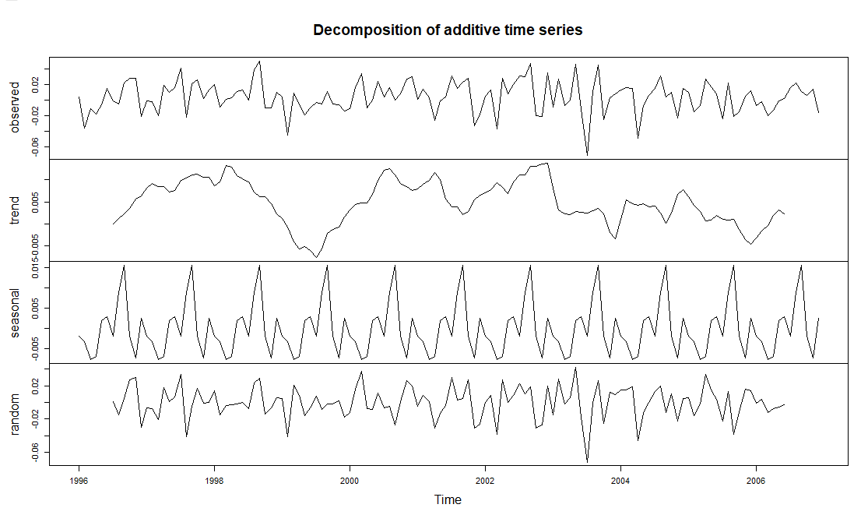
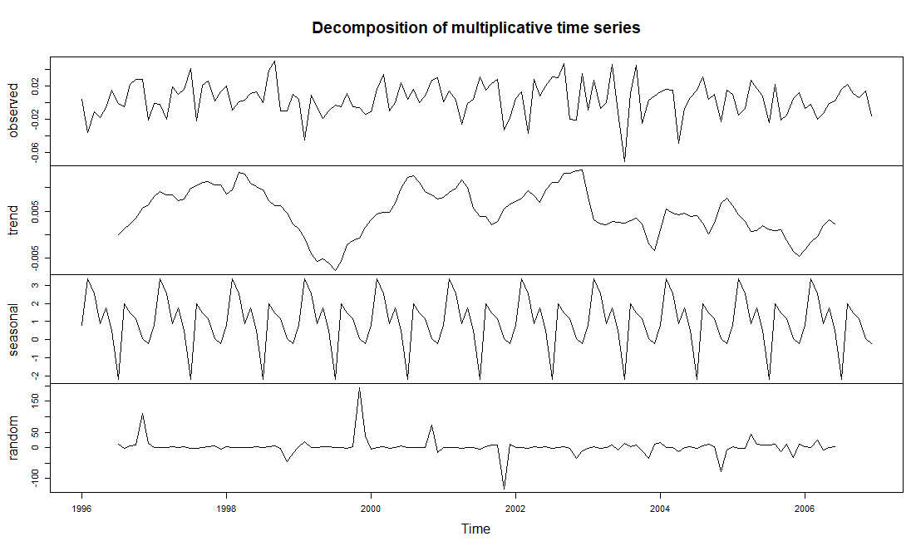

Slide 12
Stationarity and Nonstationarity
Stationarity indicates that all statistical property of a time series like mean, standard deviation etc. remains constant over the period of observation i.e. doesn’t depends on time.
If the above definition doesn’t holds, the time series is nonstationary.
One method of converting nonstationary time series to a stationary time series is by taking difference.
diff is a very useful R function to perform difference.

Slide 13
Test of Stationarity
There are few ways to identify that the series is stationary or not. One of them is augmented Dickey–Fuller test (ADF). Our null hypothesis of this test is that the series is nonstationary. The alternate hypothesis is that the series is stationary.
library(tseries)
adf.test(us10)

Slide 15
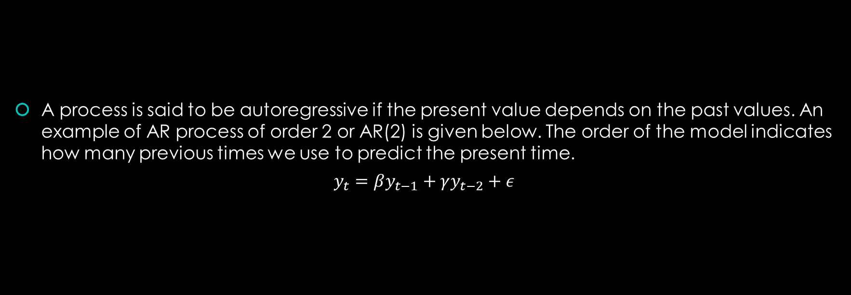
Auto-Regressive (AR) process
A process is said to be autoregressive if the present value depends on the past values. An example of AR process of order 2 or AR(2) is given below. The order of the model indicates how many previous times we use to predict the present time.
$$y_{t}=βy_{t−1}+γy_{t−2}+ε$$

Slide 16

Random Walk process
A random walk process in basically AR (1) process without the fixed coefficient.
$$y_{t}={αy}_{t−1}+ ε,α<1$$

Slide 17
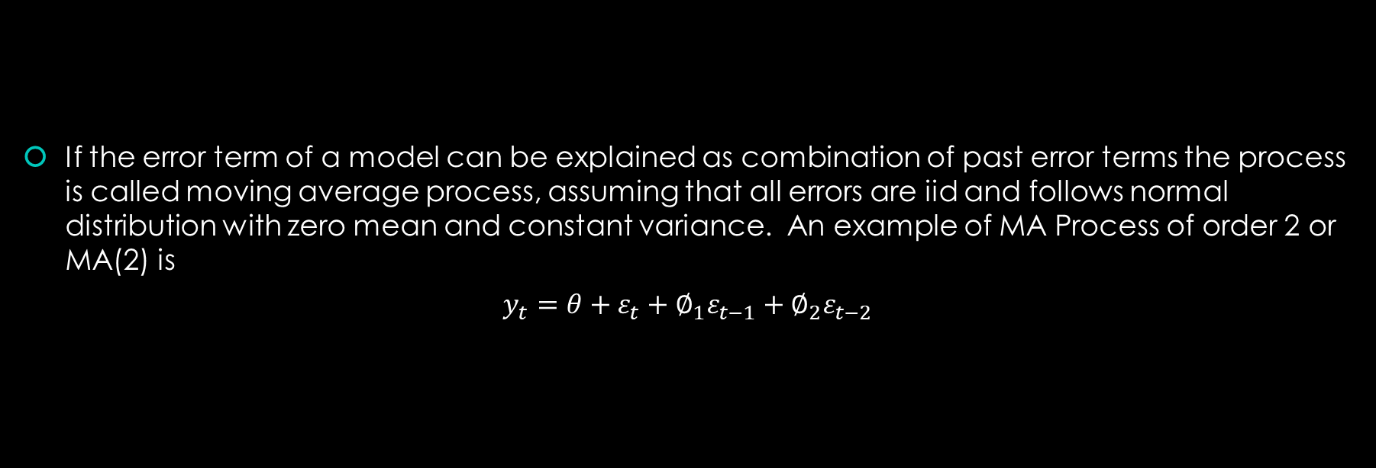
Moving Average (MA) Process
If the error term of a model can be explained as combination of past error terms the process is called moving average process, assuming that all errors are iid and follows normal distribution with zero mean and constant variance. An example of MA Process of order 2 or MA(2) is
$$y_{t}=θ+ε_{t}+∅_{1}ε_{t−1}+∅_{2}ε_{t−2}$$

Slide 18
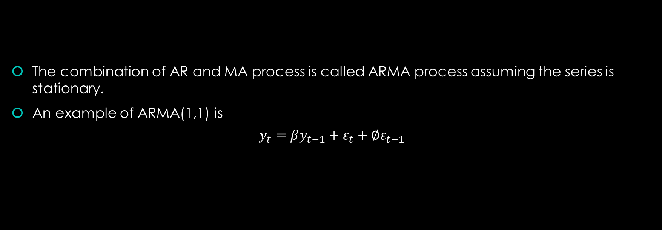
Auto-Regressive and Moving Average
The combination of AR and MA process is called ARMA process assuming the series is stationary.
An example of ARMA(1,1) is
$$y_{t}=βy_{t−1}+ε_{t}+∅ε_{t−1}$$

Slide 19
Auto-Regressive Integrated Moving Average (ARIMA)
Same as ARMA but with a added term “I”. “I” represents the number of time the difference is taken to make the series stationary. We can’t develop a good model with a non stationary process, therefore we need to take difference to make the series stationary.
auto.arima is an excellent R function which is part of forecast package to do ARIMA modeling

Slide 20
Let’s jump into R and see them in action

Slide 21
Thank You

